Slide 1



Savvy Care Skincare Refill Management Tool
Jin Yan
Week 4 demo

Slide 2
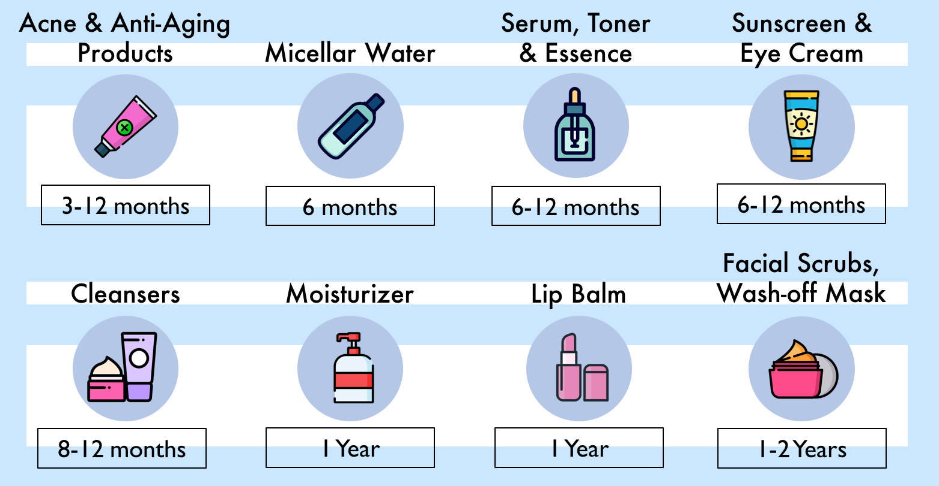
The Average Cost of Beauty Maintenance Could Put You Through Harvard
Beauty maintenance cost:
Long shelf life:
$313 per month
$3756 per year
$225,360
lifetime
What is Savvy Care?
Deals & Steals Tool ML models for discount estimation to support cost reduction and purchasing decisions for loyalty skincare customers.
www.SavvyCare.com (under development)

Slide 3



Rich dataset on Past Skincare Discounts
Data Source
Data Preparation
Modeling
Feature Engineering
Deliverables
Top 12 popular skincare brands
Discount info from 2010 – 2020
Data source: dealmoon.com
Web Scraping: Selenium

Slide 4
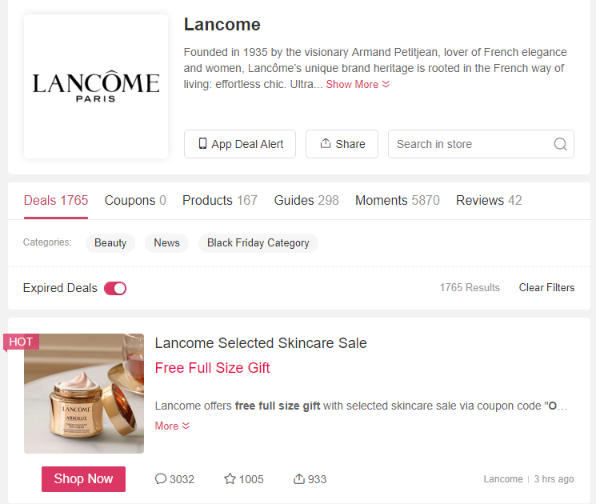



From Raw Data to Prediction
Data Source
Data Preparation
Modeling
Feature Engineering
Deliverables
Labels:
Gift with purchase (GWP)
% off
Discount
next week?
Gift?

Slide 5
From Raw Data to Prediction
Data Source
Data Preparation
Modeling
Feature Engineering
Deliverables
Calendar Features
Year, month, day
Weekend or not
Lag Features
Discount past 1 day/1 week/2 weeks/1 month
Rolling Window Statistics
Max, mean, min past 1 day/1 week/2 weeks/1 month
A week from holiday or not
GWP past 1 day/1 week/2 weeks/1 month

Slide 6
Predicting the Future % OFF
2010
2020
Data Source
Data Preparation
Modeling
(Regression)
Feature Engineering
Deliverables
Data
Training:
RMSE1
Testing:
3 month
RMSE2
Model Performance:
Average RMSE
RMSE3
…
RMSEn
Methods | Naïve Forecast | MLPRegressor
RMSE | 0.104 | 0.08
30% improvement

Slide 7
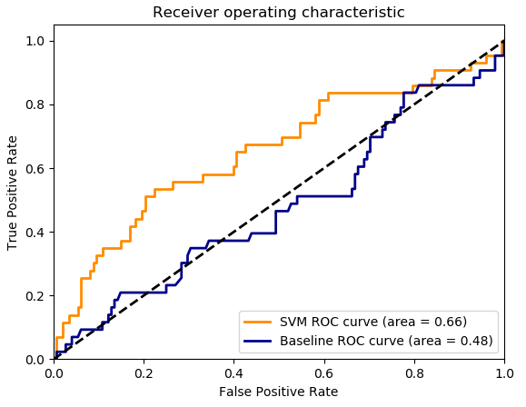
Predicting If GWP
Data Source
Data Preparation
Modeling
(Classification)
Feature Engineering
Deliverables
Challenge: extremely imbalanced, 5% occurrence of True GWP
Stratification with k-fold
Resampling to get more balanced data
Baseline: Logistic Regression
SVM improves area under ROC curve 38%
GWP | F1-score
False | 0.74
True | 0.47

Slide 8
The secrete of skincare discount!
Data Source
Data Preparation
Modeling
(Classification)
Feature Engineering
Deliverables
Fun facts:
The benefits of using Savvy Care:
Saves time
Saves money
I know I find the best deal
I know when should I refill my skincare
Deals usually happen in weekdays!
Some best discounts does not happen in Nov or Dec
Giving 15% OFF is not good enough compared with GWP
More and more deal coming in recent years

Slide 9








About Me: Jin Yan
https://www.linkedin.com/in/jyan83/
Masters in Computer Science
& Civil Engineering
yankaron@gmail.com
PhD in Civil Engineering

Slide 10


What is Savvy Care?
Deals & Steals Tool ML models for discount estimation to support cost reduction and purchasing decisions for loyalty skincare customers.
The benefits of using Savvy Care:
Saves time
I don’t have to look for discounts in multiple places
I know I find the best deal
I know when should I refill my skincare
www. SavvyCare.com (under development)

Slide 11
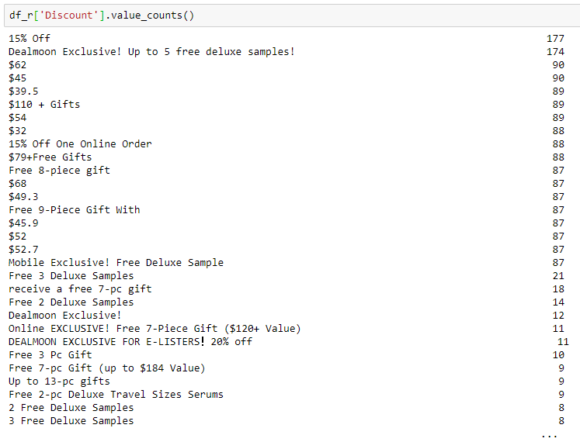
Problem framing
Day | Discount (% off) | GWP
1 | 15 | True
2 | 30 | False
3 | 15 | True
4 | ? | ?
5 | ? | ?
Data source: dealmoon.com + Web scraping: Selenium
Discount type varies, solution:
transfer discount to % off
Label GWP, “True” or False
Regression
Classification
Training: 2010-2019 daily discount information;
Testing: Recent one year’s daily discount information.
Training vs Testing: 0.89 : 0.11
Notes:
Inputs vs. Outputs
Endogenous vs. Exogenous
Unstructured vs. Structured
Regression vs. Classification
Univariate vs. Multivariate
Single-step vs. Multi-step
Contiguous vs. Discontiguous

Slide 12
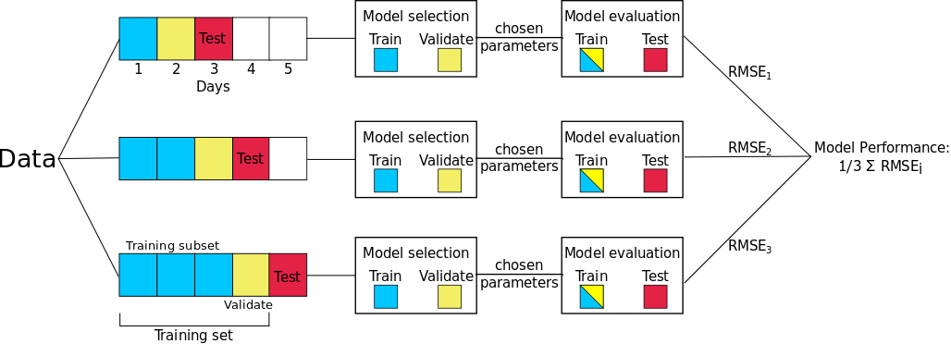

Slide 13
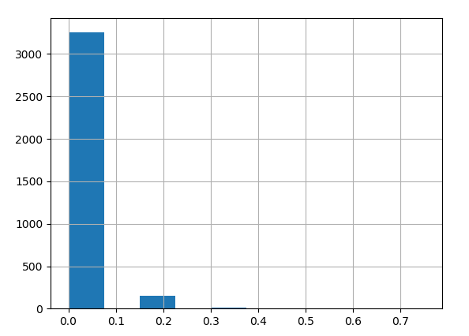
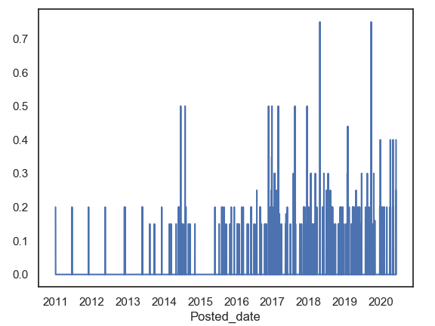
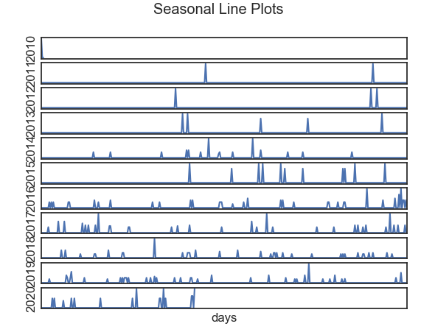
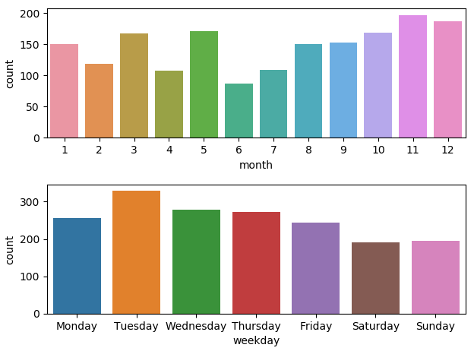
Preliminary Exploratory Analysis
Wavelet denoising
Notes:
count 3444.000000
mean 0.011641
std 0.053520
min 0.000000
25% 0.000000
50% 0.000000
75% 0.000000
max 0.750000

Slide 14
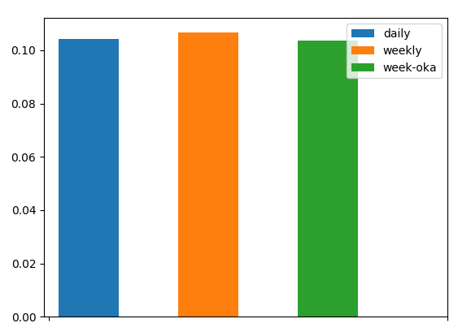
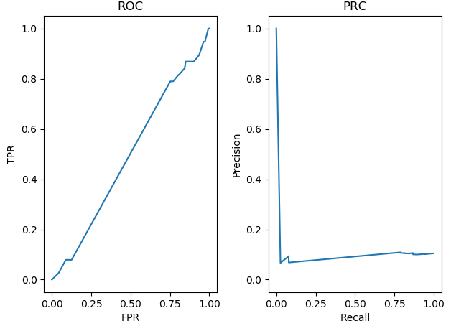
Forecast Performance Baseline
Regression: Naive Forecast | Classification: Logistic Regression
Persistence Forecast: Daily Weekly Weekly One-Year-Ago Evaluation metric: overall RMSE regardless of day Forward-chaining Cross-validation | Extremely imbalanced: 5% Accuracy: 0.89589 F1 score: 0.00000 AUROC: 0.49352 AUPRC: 0.10576
Problem
EDA
Baseline
Feature Engineering
Models
Performance
Notes:
0.1043043412538309
0.10666266018116685
0.10369810366297305

Slide 15
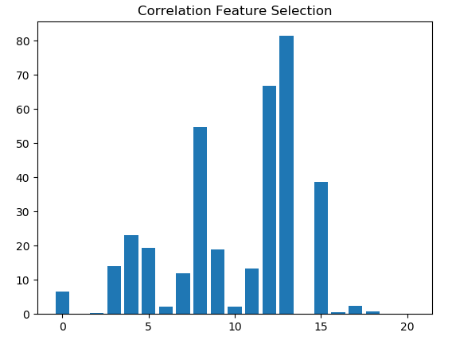
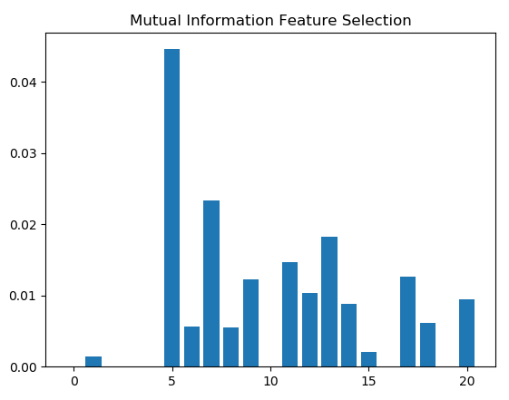
Feature Engineering
Calendar Features:
Year, month, day
Weekend or not.
A week from holiday or not.
Lag Features
Discount past 1 day/1 week/2 weeks/1 month
Rolling Window Statistics
Max, mean, min past 1 day/1 week/2 weeks/1 month
Modeling With Selected Features!

Slide 16
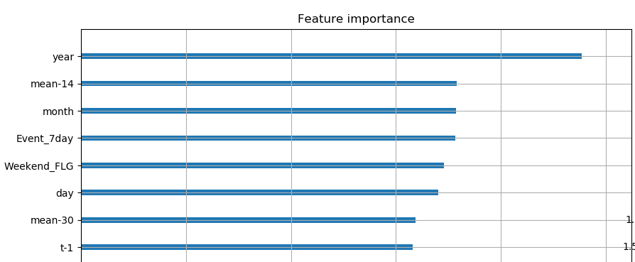

Slide 17
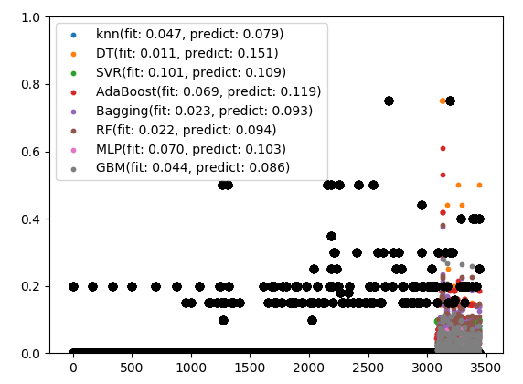
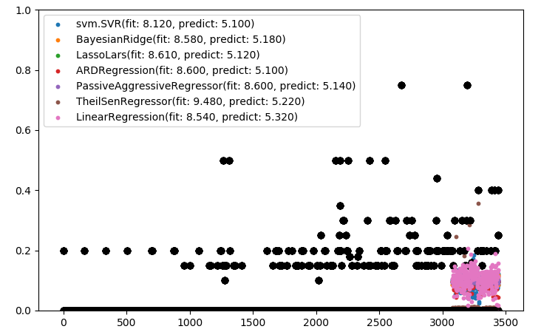
Regression Forecast
23% accuracy improvement

Slide 18
